Slide 1
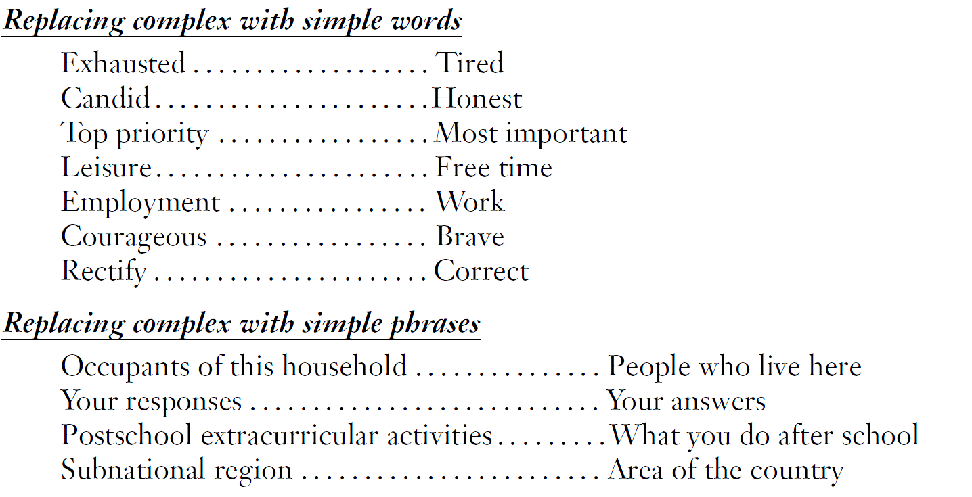
Use Simple, Familiar Language

Slide 2
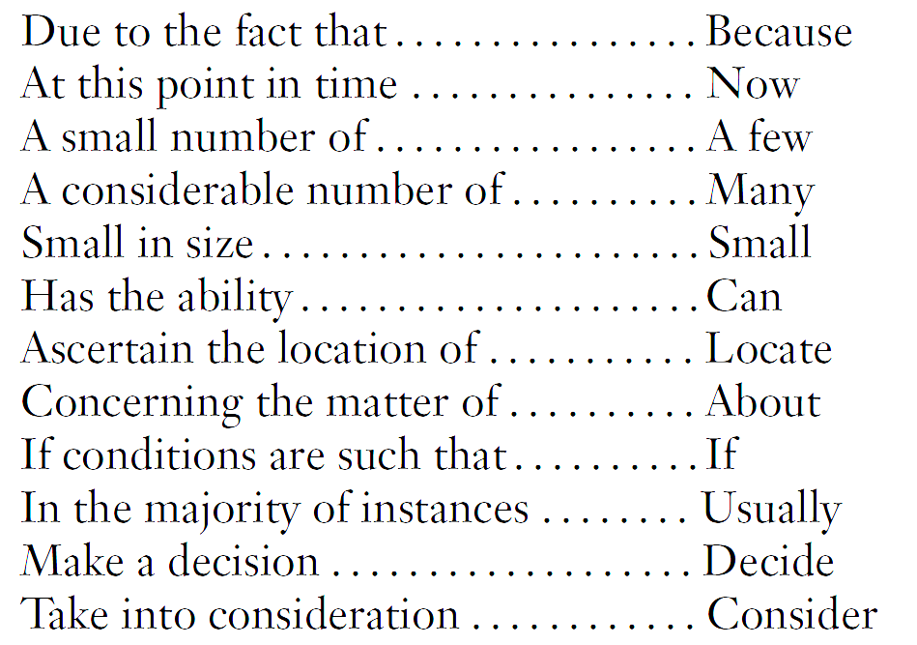
Use Few Words to Pose Questions
4. How many people were living or staying at this residence on Saturday March 3rd, 2000? To make sure each person in the United States is counted only once, it is very important to:
Include everyone who lives here whether related
to you or not, and anyone staying temporarily who
has no permanent place to live;
But do not include anyone away at college,
away in the Armed Forces, in a nursing home,
hospice, mental hospital, correctional facility,
or other institution.
Avoid Wordy Expressions
Number people at residence
Notes:
Note to remember during presentation:
Use as few words as possible to pose the question
Eliminating wordy and redundant expressions

